Slide 1
AP Human Geography
Summer Assignment
Part I - Map Practice
Walton High School

Slide 2
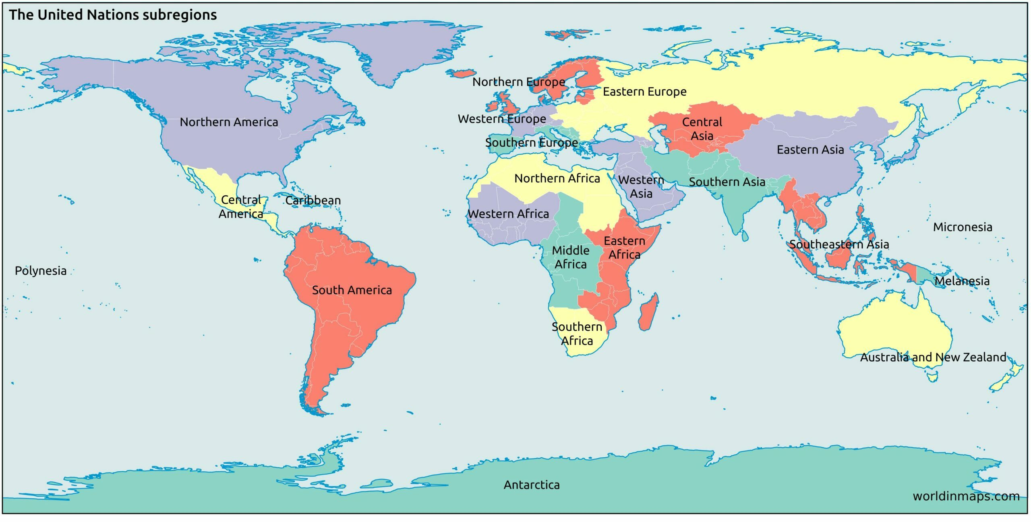
Know the major world regions detailed below. This is a map scale and scale of analysis you will use and interpret in class.
Sub-Saharan Africa
Latin
America

Slide 3
COUNTRIES YOU DO NOT HAVE TO KNOW
Fiji
Kiribati
Marshall Islands
Micronesia
Nauru
Palau
Samoa
Solomon Islands
Tonga
Tuvalu
Vanuatu
Antigua & Barbuda
Barbados
Bermuda
Dominica
Grenada
St. Kits & Nevis
St. Lucia
St. Vincent & the Grenadines
Trinidad & Tobago
Andorra
Malta
San Marino
Benin
Burkina Faso
Cape Verde
Comoros
Equatorial Guinea
Gabon
Gambia
Guinea
Guinea-Bissau
Liberia
Mauritius
Sao Tome & Principe
Senegal
Seychelles
Togo
Maldives
THE FOLLOWING ARE COUNTRIES YOU NEED TO KNOW

Slide 4
NORTH AMERICA

Slide 5
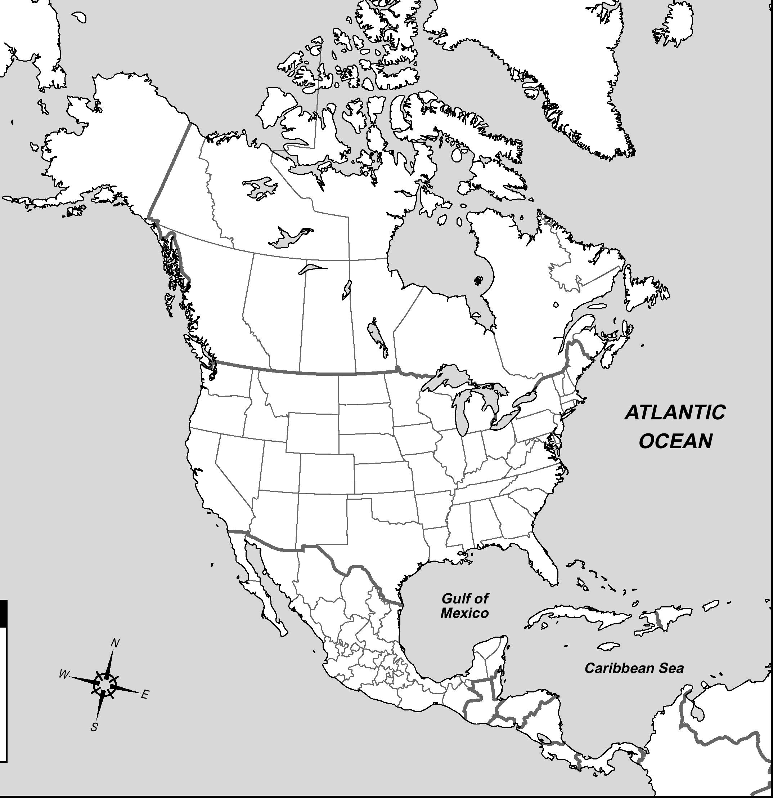
Bahamas

Slide 6
A hint for the countries of Central America ↑
People (Panama)
Can (Costa Rica)
Never (Nicaragua)
Have (Honduras)
Enough (El Salvador)
Geography (Guatemala)
Books (Belize)
Belize

Slide 7
Canada

Slide 8
Costa Rica

Slide 9
Cuba

Slide 10
Dominican Republic

Slide 11
El Salvador

Slide 12
Guatemala

Slide 13
Haiti

Slide 14
Honduras

Slide 15
Jamaica

Slide 16
Mexico

Slide 17
Nicaragua

Slide 18
Panama

Slide 19
United States of America

Slide 20
SOUTH AMERICA

Slide 21
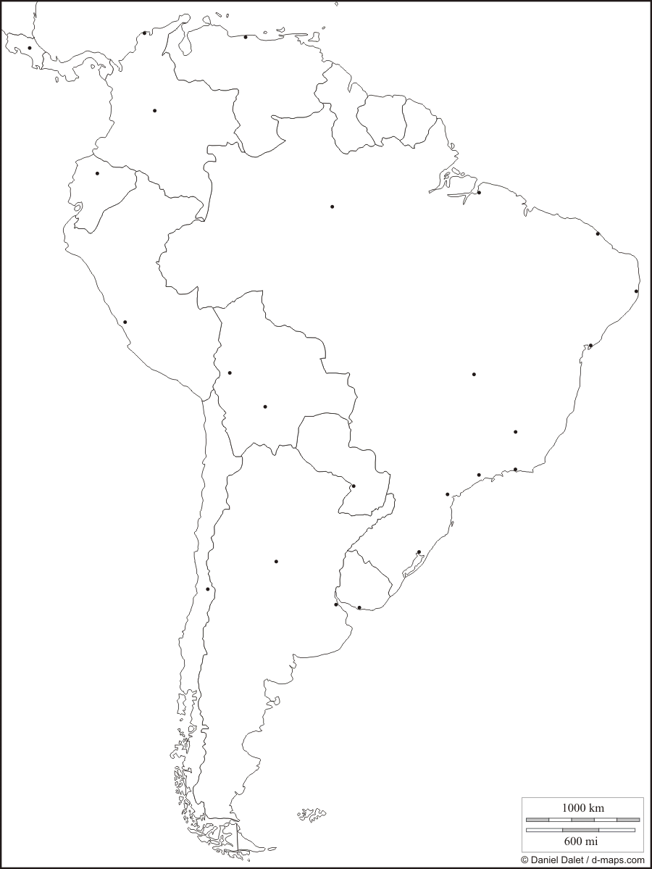
Argentina

Slide 22
Bolivia

Slide 23
Brazil

Slide 24
Chile

Slide 25
Colombia

Slide 26
Ecuador

Slide 27
French Guiana
(not a sovereign state)

Slide 28
Guyana

Slide 29
Paraguay

Slide 30
Peru

Slide 31
Suriname

Slide 32
Uruguay

Slide 33
Venezuela

Slide 34
EUROPE

Slide 35
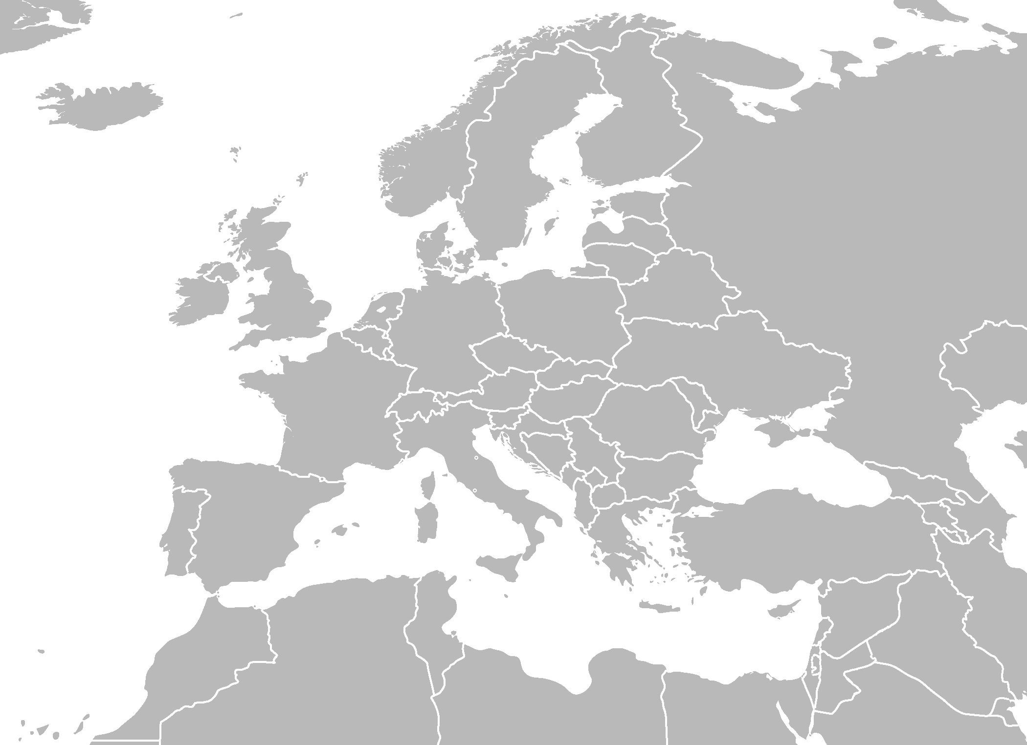
Albania

Slide 36
Austria

Slide 37
Belarus

Slide 38
Belgium

Slide 39
Bosnia & Herzegovina

Slide 40
Bulgaria

Slide 41
Croatia

Slide 42
Czech Republic

Slide 43
Denmark

Slide 44
A hint for the countries of Eastern Europe ↓ & →
E (Estonia)
L (Latvia)
L (Lithuania)
B (Belarus)
U (Ukraine)
M (Moldova)
G (Georgia)
A (Armenia)
A (Azerbaijan)
T (Turkmenistan)
U (Uzbekistan)
T (Tajikistan)
K (Kyrgyzstan)
K (Kazakhstan)
ELL-BUM-GAA-TUT-KK
Estonia

Slide 45
Finland

Slide 46
France

Slide 47
Germany

Slide 48
Greece

Slide 49
Hungary

Slide 50
Iceland

Slide 51
Ireland

Slide 52
Italy

Slide 53
Kosovo

Slide 54
Latvia

Slide 55
Liechtenstein
(the tiny one between Switzerland and Austria)

Slide 56
Lithuania

Slide 57
Luxembourg

Slide 58
Macedonia (F.Y.R.O.M.)

Slide 59
Moldova

Slide 60
Montenegro

Slide 61
Netherlands

Slide 62
Norway
A hint for the countries of Scandanavia →
Not (Norway)
So (Sweden)
Fine (Finland)

Slide 63
Poland

Slide 64
Portugal

Slide 65
Romania

Slide 66
Russia

Slide 67
Serbia

Slide 68
Slovakia

Slide 69
Slovenia

Slide 70
Spain

Slide 71
Sweden

Slide 72
Switzerland

Slide 73
Ukraine

Slide 74
United Kingdom

Slide 75
AFRICA

Slide 76
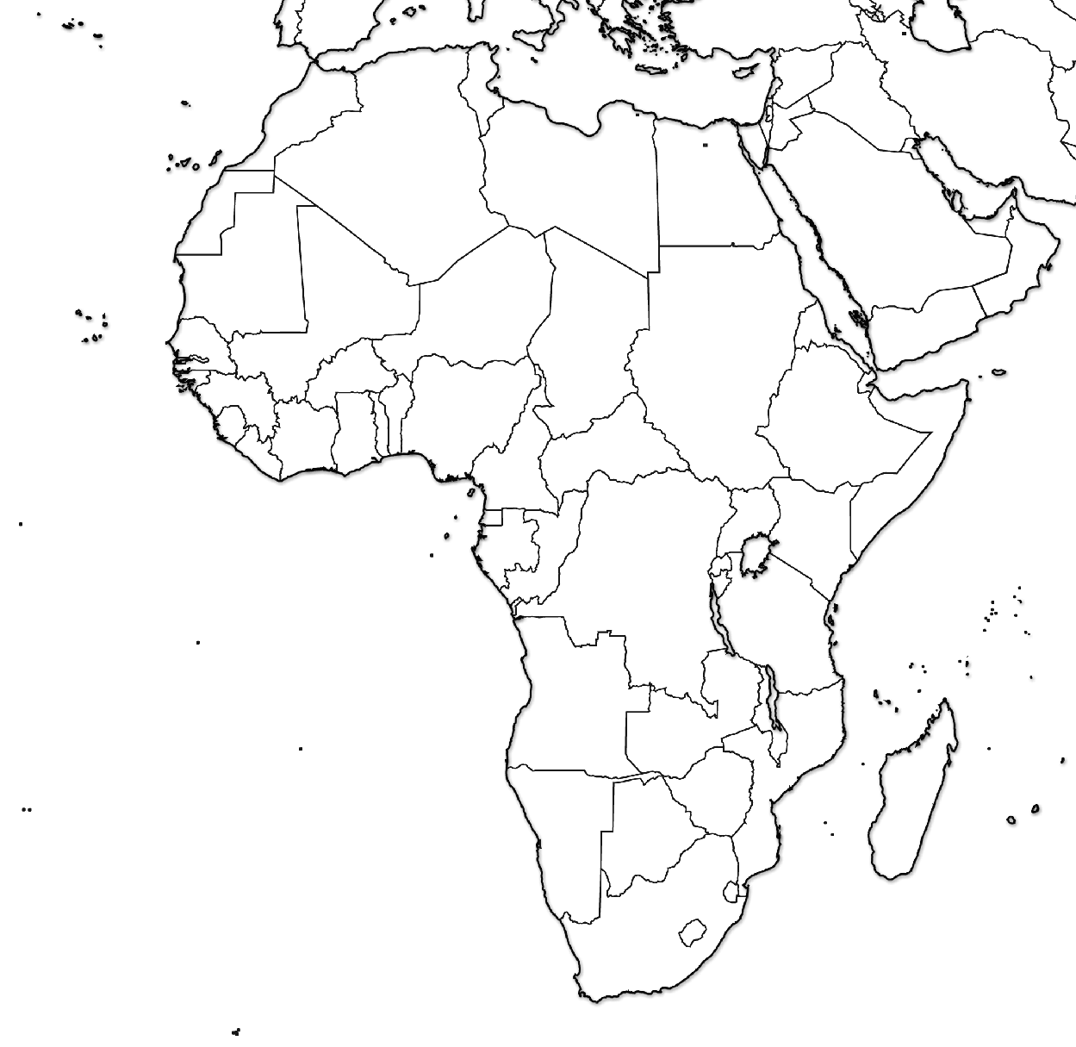
Algeria

Slide 77
Angola

Slide 78
A hint for the countries of Southeast Africa ↑→
Ben’s (Botswana)
Zany (Zimbabwe)
Zebra (Zambia)
Munches (Malawi)
Mushy (Mozambique)
Melons (Madagascar)
Botswana

Slide 79
Burkina Faso

Slide 80
Burundi

Slide 81
A hint for the countries of Southwest Africa ↓
Cameron’s (Cameroon)
Car (C.A.R.)
Eats (Equatorial Guinea)
Gas (Gabon)
Rolling (Rep. of Congo)
Down (D.R.C.)
A (Angola)
Narrow (Namibia)
Street (South Africa)
Leading (Lesotho)
South (Swaziland)
Cameroon

Slide 82
Central African Republic (C.A.R.)

Slide 83
A hint for the countries of North Africa →
My (Mauritania)
Mother (Mali)
Never (Niger)
Cooks (Chad)
Scrambled (Sudan)
Eggs (Eritrea)
Chad

Slide 84
Côte d'Ivoire
(Ivory Coast)

Slide 85
Democratic Republic of the Congo (D.R.C.)

Slide 86
Djibouti

Slide 87
Egypt

Slide 88
Eritrea

Slide 89
Ethiopia

Slide 90
Gabon

Slide 91
Ghana

Slide 92
Kenya

Slide 93
Lesotho

Slide 94
Liberia

Slide 95
Libya

Slide 96
Madagascar

Slide 97
Malawi

Slide 98
Mali

Slide 99
Mauritania

Slide 100
Morocco

Slide 101
Mozambique

Slide 102
Namibia

Slide 103
Niger

Slide 104
Nigeria

Slide 105
Republic of Congo

Slide 106
Rwanda

Slide 107
Somalia

Slide 108
South Africa

Slide 109
South Sudan

Slide 110
Sudan

Slide 111
Swaziland

Slide 112
A hint for the countries of Eastern Africa ↑
The (Tanzania)
Blue (Burundi)
Rabbit’s (Rwanda)
Umbrella (Uganda)
Kept (Kenya)
Everyone (Ethiopia)
Dry (Djibouti)
Sunday (Somalia)
Tanzania

Slide 113
Tunisia

Slide 114
Uganda

Slide 115
Zambia

Slide 116
Zimbabwe

Slide 117
ASIA

Slide 118
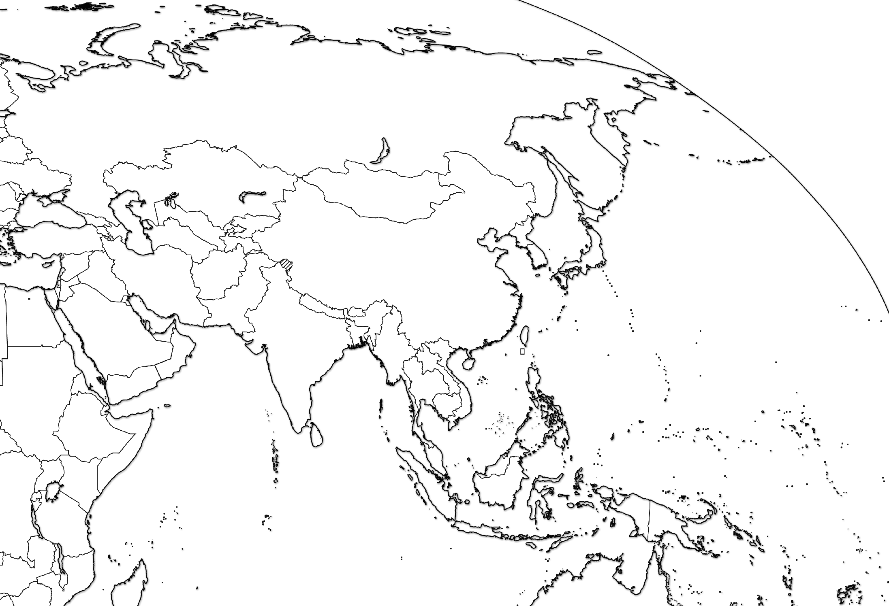
Afghanistan

Slide 119
A hint for the countries of Central Asia →
E (Estonia)
L (Latvia)
L (Lithuania)
B (Belarus)
U (Ukraine)
M (Moldova)
G (Georgia)
A (Armenia)
A (Azerbaijan)
T (Turkmenistan)
U (Uzbekistan)
T (Tajikistan)
K (Kyrgyzstan)
K (Kazakhstan)
ELL-BUM-GAA-TUT-KK
Armenia

Slide 120
Azerbaijan

Slide 121
Bahrain
the tiny islands next to the bigger island

Slide 122
Bangladesh

Slide 123
Bhutan

Slide 124
Brunei

Slide 125
Cambodia

Slide 126
China

Slide 127
Cyprus

Slide 128
Georgia

Slide 129
India

Slide 130
Indonesia

Slide 131
Iran

Slide 132
Iraq

Slide 133
Israel

Slide 134
Japan

Slide 135
Jordan

Slide 136
Kazakhstan

Slide 137
Kuwait

Slide 138
Kyrgyzstan

Slide 139
Laos

Slide 140
Lebanon

Slide 141
Malaysia

Slide 142
Mongolia

Slide 143
Myanmar (Burma)

Slide 144
Nepal

Slide 145
North Korea

Slide 146
Oman

Slide 147
Pakistan

Slide 148
Philippines

Slide 149
Qatar

Slide 150
Russia

Slide 151
Saudi Arabia

Slide 152
Singapore

Slide 153
South Korea

Slide 154
Sri Lanka

Slide 155
Syria

Slide 156
Taiwan

Slide 157
Tajikistan

Slide 158
Thailand

Slide 159
Timor Leste
(East Timor)

Slide 160
Turkey

Slide 161
Turkmenistan

Slide 162
United Arab Emirates (U.A.E.)

Slide 163
Uzbekistan

Slide 164
Vietnam

Slide 165
Yemen

Slide 166
AUSTRALIA & OCEANIA

Slide 167
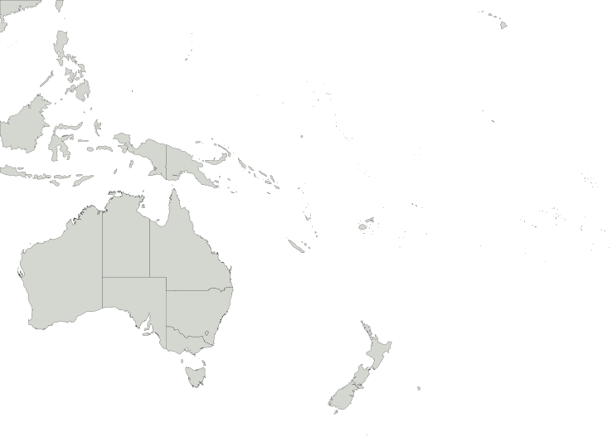
Australia

Slide 168
New Zealand

Slide 169
Papua New Guinea

Slide 170
Test Yourself
- Under “geography”
- Search for “parisaday”
http://www.sporcle.com/
http://www.purposegames.com/
http://www.lizardpoint.com/fun/geoquiz/
http://www.travelpod.com/traveler-iq
http://www.ilike2learn.com/ilike2learn/geography.asp
http://www.maps.com/funfacts.aspx
http://www.sheppardsoftware.com/Geography.htm
http://www.funbrain.com/where/
http://www.jetpunk.com/quizzes/map-quiz-europe.php
http://www.yourchildlearns.com/map-puzzles.htm
http://sites.google.com/site/geogeomania/geographygames
Tap Quiz Apps (for your smart phone)
or print one of these regional maps and try to label it

Slide 171
Global & Local Regions or Areas of Interest

Slide 172
Chechnya

Slide 173
N & S Ossetia

Slide 174
Kurdistan

Slide 175
Basque

Slide 176
Catalonia

Slide 177
West Bank

Slide 178
Gaza Strip

Slide 179
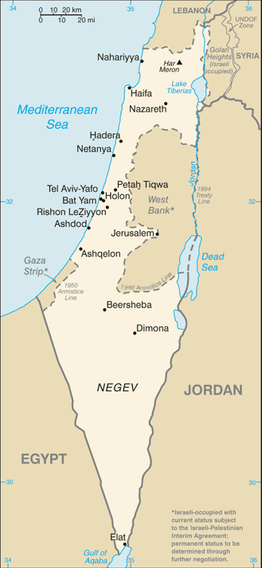
West Bank
Gaza Strip

Slide 180
Punjab

Slide 181
Tibet

Slide 182
Kashmir

Slide 183
Nunavut

Slide 184
Quebec

Slide 185
F.A.R.C.
(areas controlled by the
Revolutionary Armed Forces of Colombia)

Slide 186
Maghreb

Slide 187
The Sahel

Slide 188
Darfur

Slide 189
Western Sahara

Slide 190
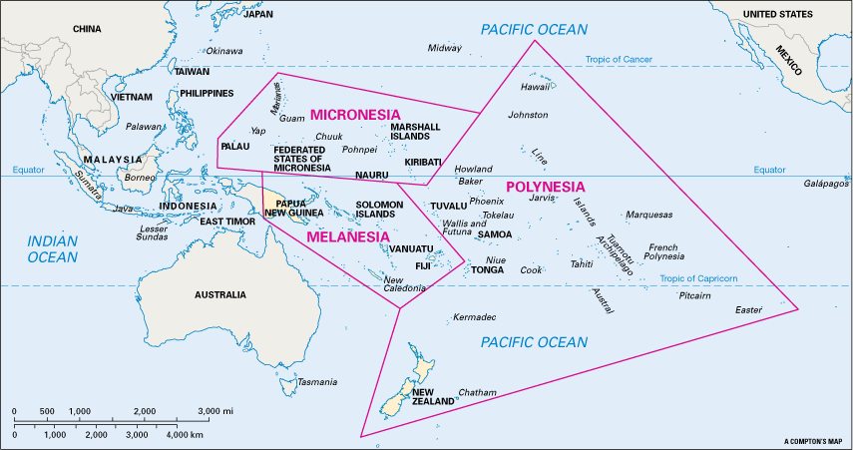
Melanesia
(includes Papua New Guinea)

Slide 191
Micronesia

Slide 192
Polynesia
(includes Hawaii & NZ)

Slide 193
TYPES OF MAPS
There are two major categories of maps:
Reference: designed to give people general info about places. Tell us where things are.
  Political Maps, Physical Maps, & Road Maps
2. Thematic: show spatial aspects of information &
data. Tells us characteristics about a place.
  Choropleth Maps, Dot Density Maps,
Graduated Symbol Maps, Cartogram Maps &
Isoline Maps

Slide 194
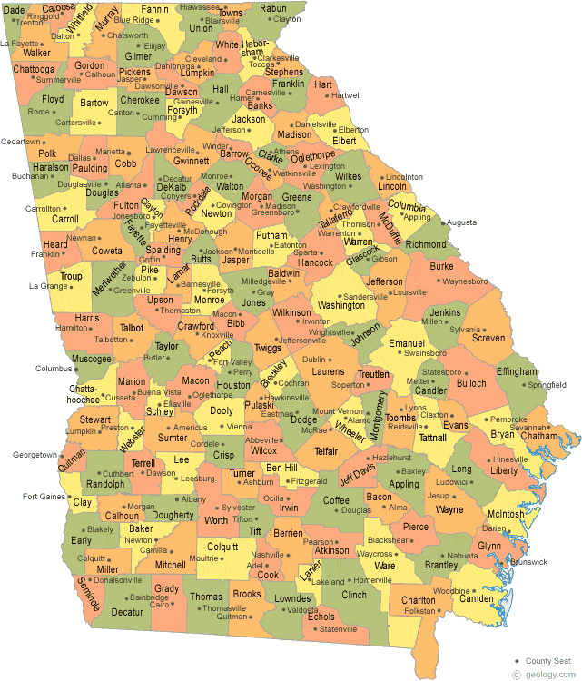
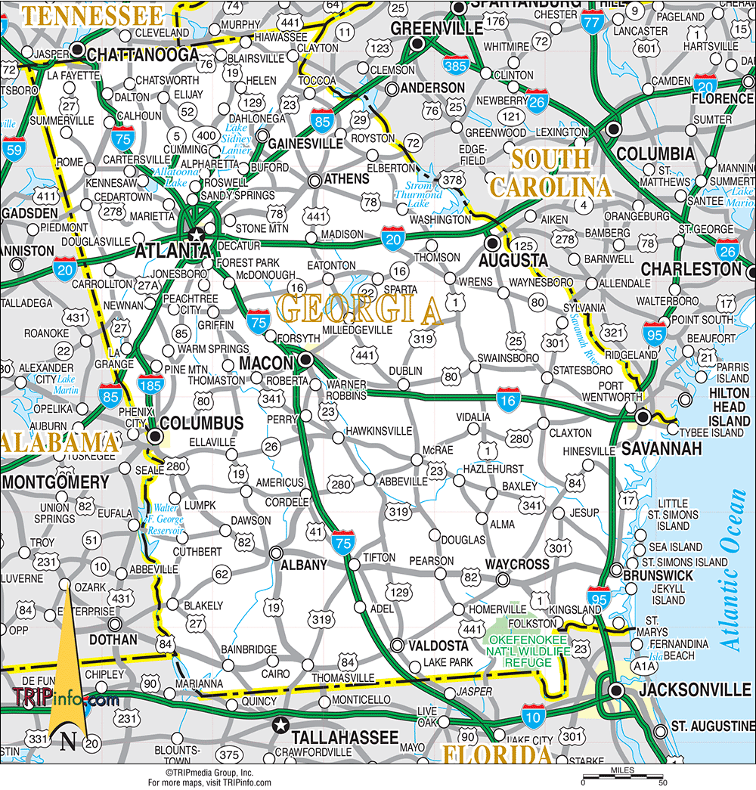
TYPES OF REFERENCE MAPS
Political Map
Road Map

Slide 195
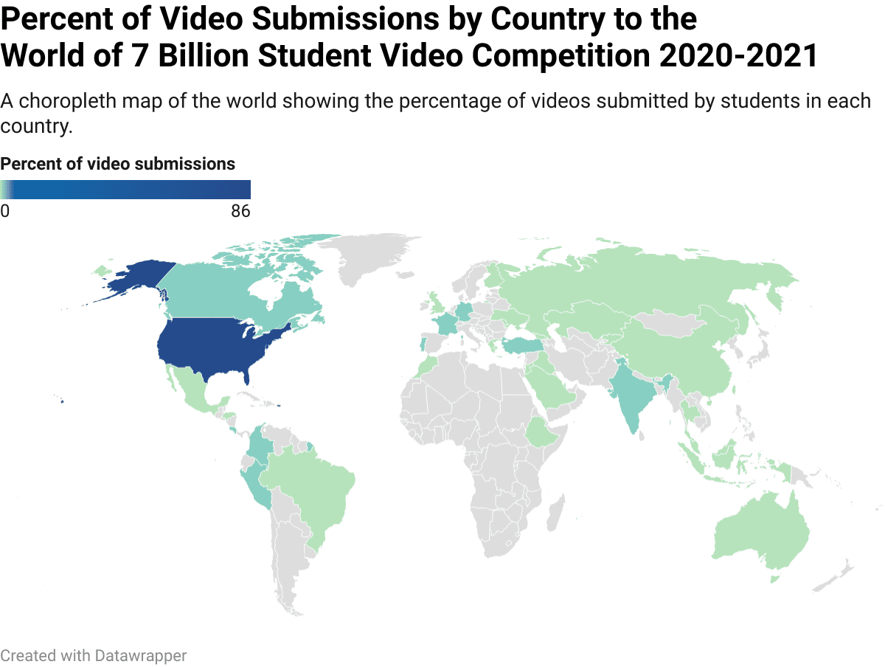
TYPES OF THEMATIC MAPS: Choropleth
Uses color to show different values of data.

Slide 196
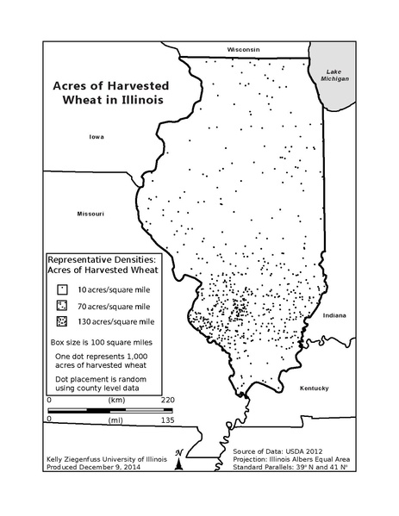
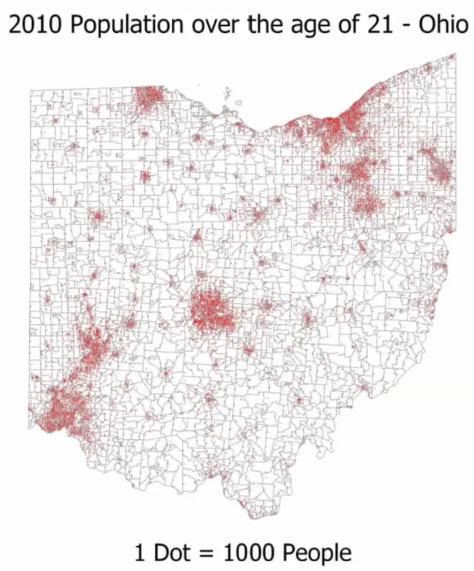
TYPES OF THEMATIC MAPS: Dot Density
Uses dots of the same size to show density & distribution of data.

Slide 197
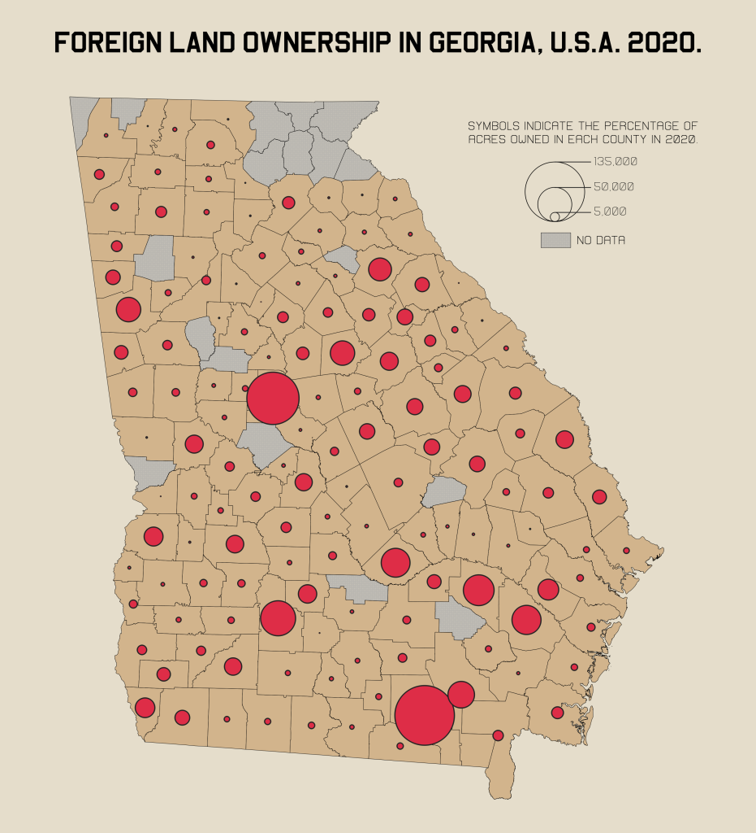
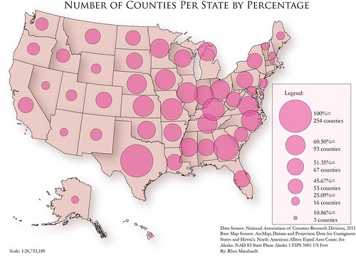
TYPES OF THEMATIC MAPS: Graduated Symbol
Uses shapes of different sizes (usually a circle) to show values of data. AKA Proportional Symbol Map

Slide 198
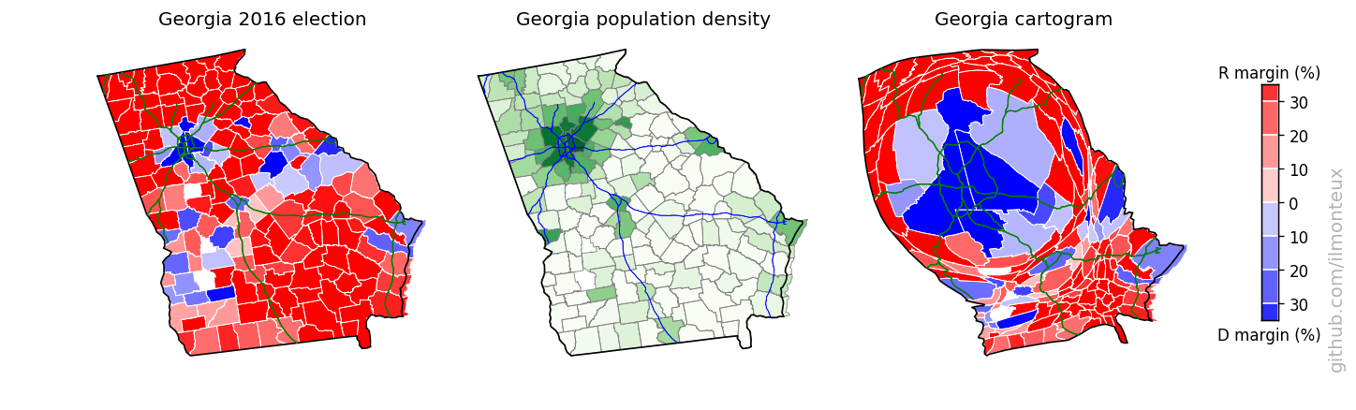
TYPES OF THEMATIC MAPS: Cartogram
The size of a place (state, county, province) is shown according to a specific data point.
Cartogram Map
Size of GA counties distorted to show population
Choropleth Maps

Slide 199
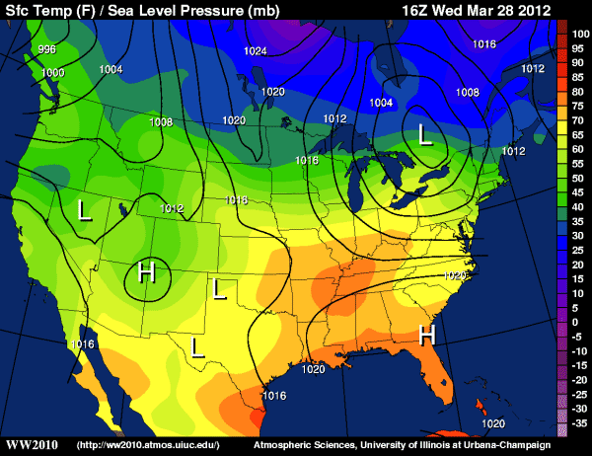
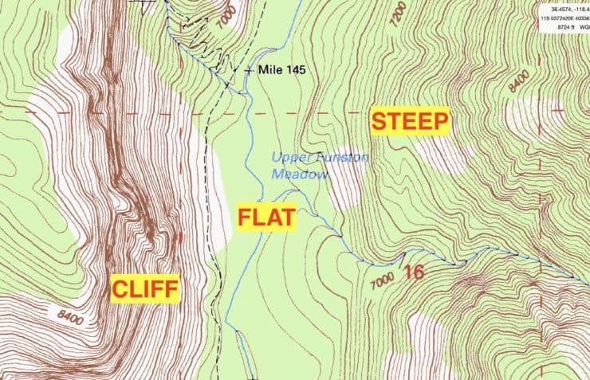
TYPES OF THEMATIC MAPS: Isometric/Isoline
Uses lines that connect points or areas of equal value to show variations of data across a place. Close lines = rapid change. Lines farther apart = less change.

Slide 200
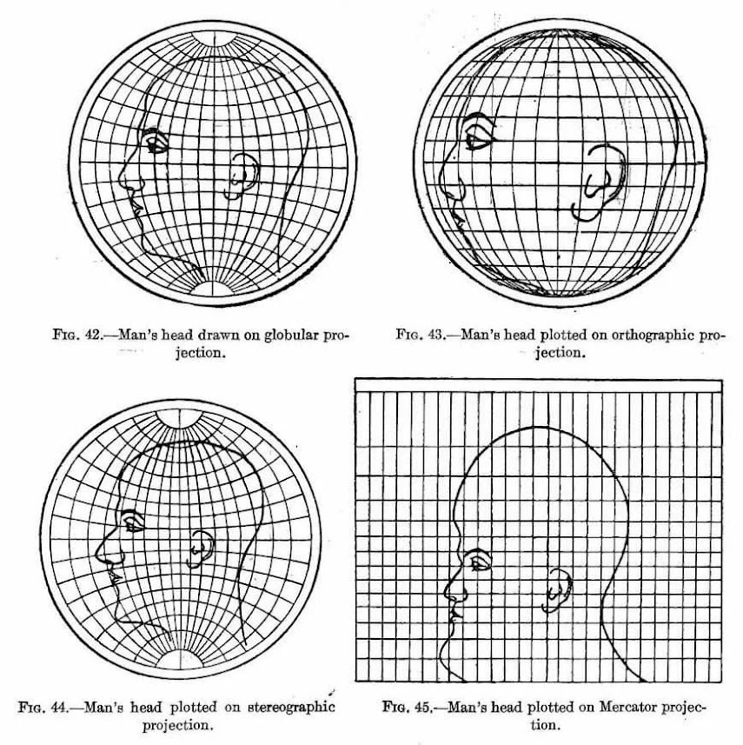
MAP PROJECTIONS: a projection is when a curved surface is shown on a flat surface. Because the Earth is a sphere and maps are flat, all maps distort some aspect of reality. All maps are SADD.
Shape can be distorted.
Area or size can be distorted.
Distance can be distorted.
Direction can be distorted.
The most accurate part of
a projection is the center.
This guys ear.

Slide 201
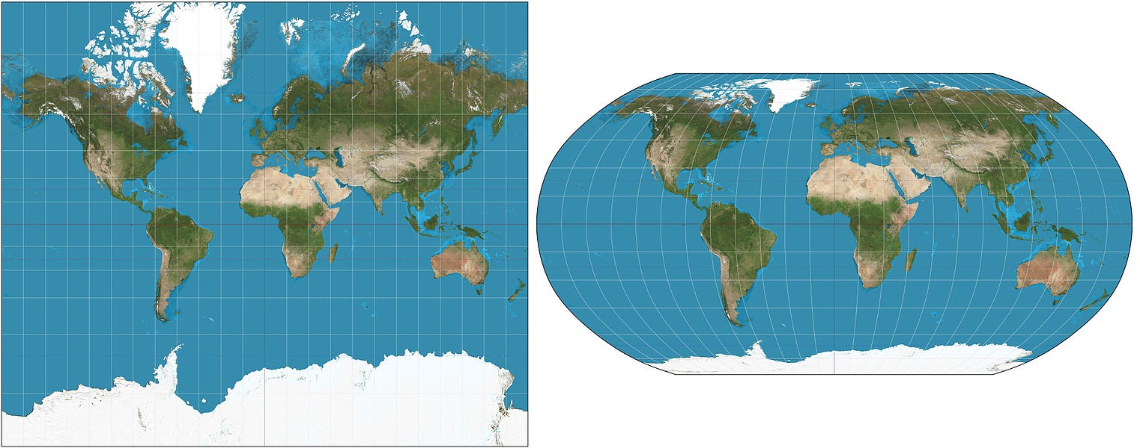
MAP PROJECTIONS TO KNOW: MERCATOR
Purpose: Navigation
Strengths: Directions are constant & accurate.
Distortion: Area of places near poles appear much larger than reality.

Slide 202
MAP PROJECTIONS TO KNOW: ROBINSON
Purpose: General use, like in classrooms.
Strengths: No major distortion.
Distortion: Area, shape, size, and direction are all slightly distorted.

Slide 203
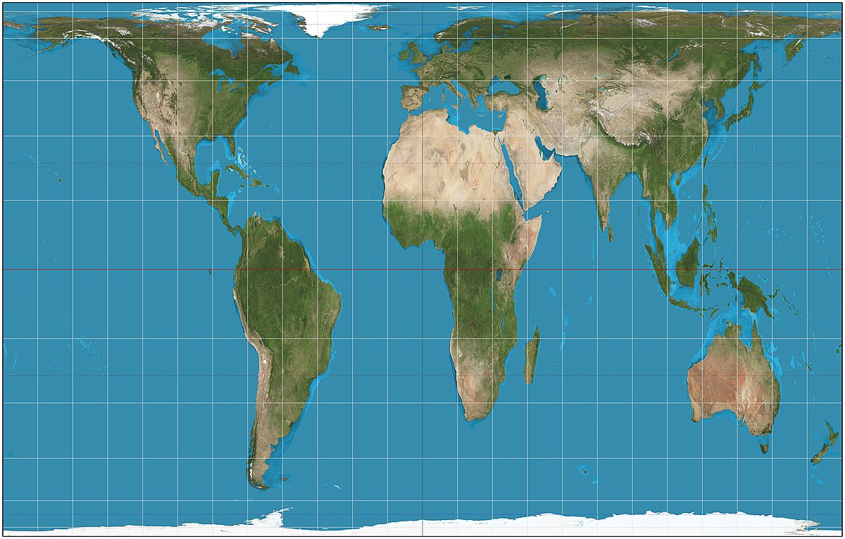
MAP PROJECTIONS TO KNOW: PETERS
Purpose: Spatial distributions related to area.
Strengths: Size of places are shown accurately.
Distortion: Shapes are inaccurate, especially near the poles.

Slide 204
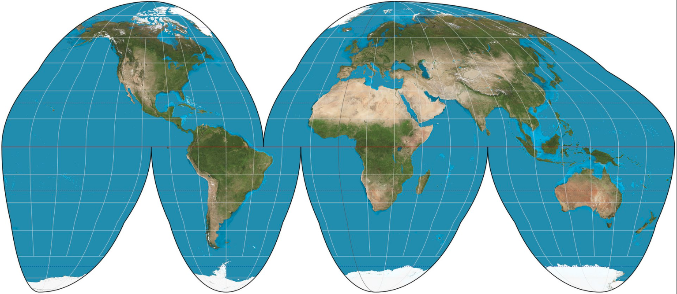
MAP PROJECTIONS TO KNOW: EQUAL-AREA
Purpose: General use & for data distributions.
Strengths: Size very close to reality.
Distortion: Shape & Distance are distorted. AKA Orange-Peel Projection

Slide 205
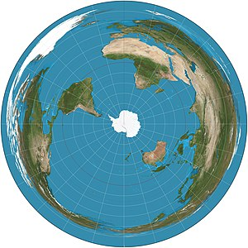
MAP PROJECTIONS TO KNOW: AZIMUTHAL
Purpose: To show the poles accurately.
Strengths: Distances from poles shown accurately.
Distortion: Direction and size are distorted, especially near edges. AKA Polar Projection.

